Slide 1

Gene expression and gene regulatory network analysis with statistical methods and machine learning algorithms
Technological Educational Institute of Crete School of Engineering Department of Electrical and Computer Engineering
Student: Droumalia Fotini TP4766
Supervisors: Tsiknakis Manolis, Koumakis Lefteris
Notes:
Title: Ανάλυση εκφράσεων γονιδίων και ρυθμιστικών δικτύων γονιδίων με στατιστικές μεθόδους και μεθόδους μηχανικής μάθησης

Slide 2
Contents
Objectives of the Research
Introduction
Literature Review
Methodology
Results Analysis
Conclusions
Discussion
Future Work
Notes:
Θα ξεκινήσουμε την παρουσίαση με...
Β. Αναφορά σε βασικούς όρους για την κατανόηση του πεδίου της πτυχιακής εργασίας
Discussion: πώς τα συμπεράσματά μας συμβαδίζουν με προηγούμενες μελέτες

Slide 3
Objectives of the Research
Implement and analyze available pathway scoring techniques in order to confirm that non-binary expression data are more efficient
Discover any non-binary pathway analysis tools that could be used for real-time/online predictions
Comparing statistical and machine learning approaches to pathway analysis

Slide 4
Molecular Biology
The field of molecular biology is concerned with the molecular foundations of biological activity
It is focused on genes and proteins, and the interactions among these molecules
It includes a variety of techniques designed to help researchers comprehend how molecules operate

Slide 5
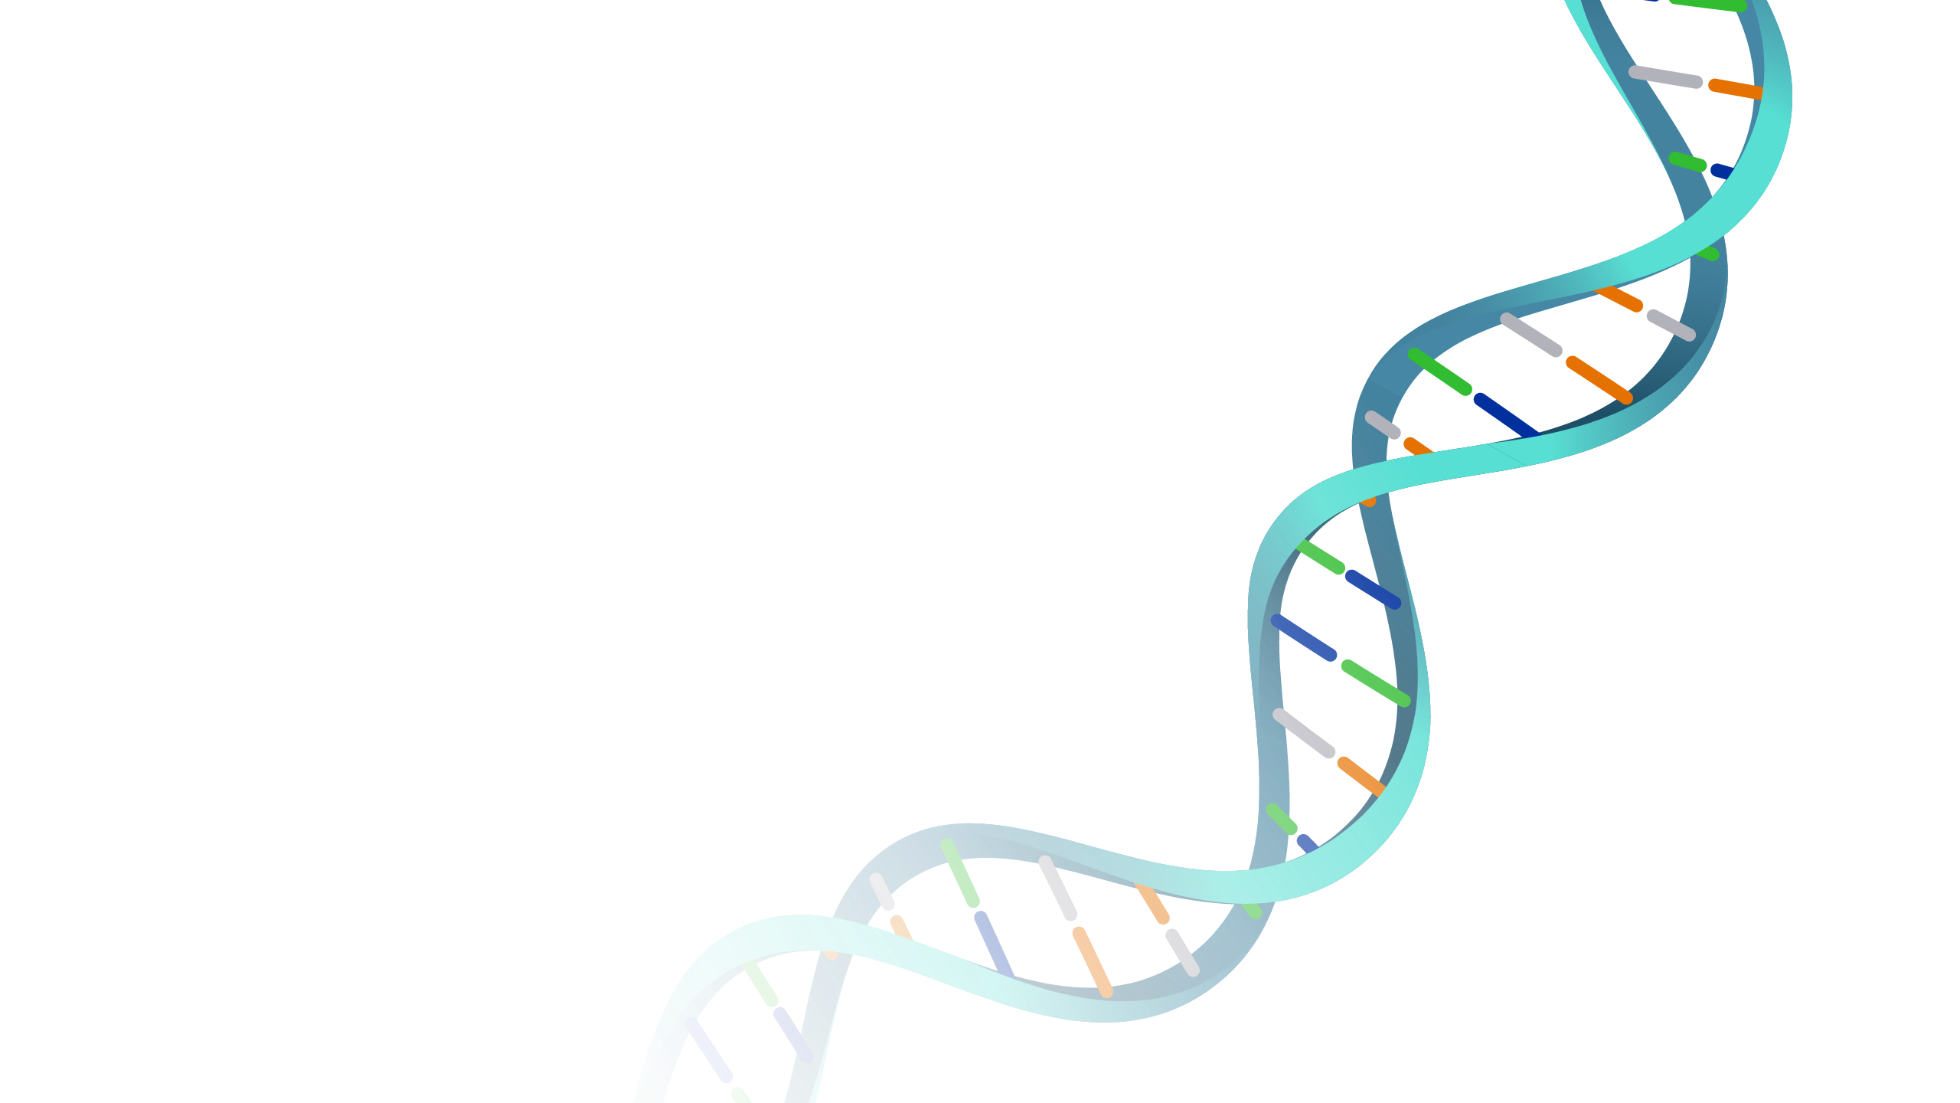
DNA
It contains all the genetic materials required for an organism to develop and function
Its design resembles a double helix, which is a twisted ladder formed by two connected strings that spiral around one another
The central dogma of molecular biology is the process of generating functional cells in compliance with DNA instructions
Notes:
Είναι ένα νουκλεϊκό οξύ που φέρει το γενετικό υλικό, είναι αποθηκευμένο στον πυρήνα του κυττάρου
Αποτελείται από δύο πολυνουκλεοτιδικές αλυσίδες (διπλή έλικα), αζωτούχες βάσεις (αδενίνη, θυμίνη, γουανίνη, κυτοσίνη)
Κεντρικό δόγμα της βιολογίας: πως η γενετική πληροφορία ρέει προς τις πρωτεΐνες

Slide 6
Gene
It is made up of DNA and serves as the basic structural and functional unit of inheritance
It is important for the synthesis of proteins, which are vital for the development, function, and regulation of the body's tissues and organs
The entire genetic code of an organism is known as genome
The entire genome was successfully sequenced by the Human Genome Project in 2022
Notes:
Δομική και λειτουργική μονάδα της κληρονομικότητας
Δομική: αποτελεί μέρος του DNA
Λειτουργική: κωδικοποιούν πρωτεΐνες (υπεύθυνες για διάφορες λειτουργίες ενός οργανισμού)
Κληρονομικότητα: μεταφορά γενετικής πληροφορίας από γενιά σε γενιά
Αλληλούχιση ολόκληρου του DNA, δηλ. ανάγνωση όλου του γονιδιώματος

Slide 7
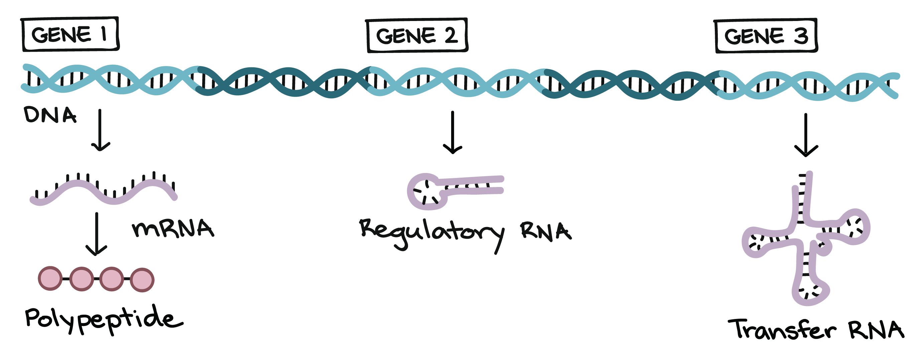
Gene Expression
The procedure by which genes control protein synthesis, that is when and where the RNA molecules and proteins are produced, to achieve the desirable results
Genes are typically classified as "expressed" or "non-expressed" depending on whether a cell generates the protein that a gene encodes or not
Notes:
Κατηγοριοποίηση σε δύο διακριτές ομάδες: δεν εκμεταλλεύεται στο έπακρο την διαθέσιμη πληροφορία, νέες έρευνες και μέθοδοι που διευρύνουν τις κατηγορίες

Slide 8
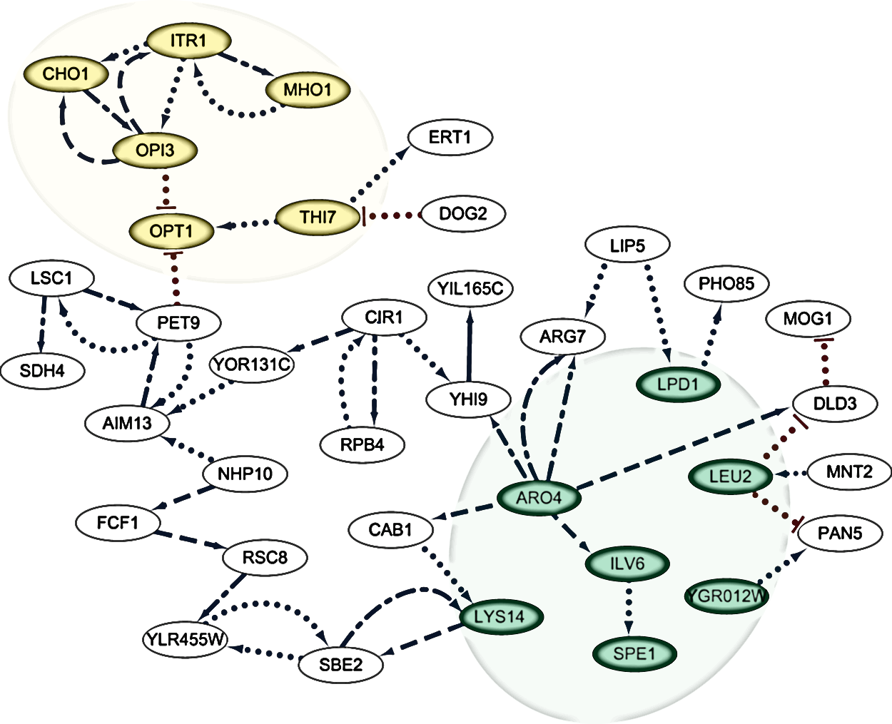
Gene Regulatory Networks I
They are sets of genes that interact with one another and can be described with the usage of graphs
Every gene is represented by a node and a pathway’s edge denotes any connection or other kind of interaction between the nodes
Notes:
Γενετικά Ρυθμιστικά Δίκτυα

Slide 9
Gene Regulatory Networks II
To represent these networks, mathematical and computational models can be used to explain the mechanisms behind the regulatory activities performed by genes
They are useful for:
Identifying circuits that can be used for a certain task
Understand the flow of information in biological systems
Predict alterations in gene expression under various conditions
Notes:
Διαχείριση, μελέτη και ανάλυση δικτύου: χρήση μαθηματικών και υπολογιστικών μοντέλων

Slide 10
Pathway Analysis
It utilizes data from both molecular pathway networks and gene expression analysis to determine significantly affected pathways in a particular scenario and to decipher the biological significance of differentially expressed genes and proteins
The word "Pathway" describes the network of molecular interactions, reactions, and relationships as it appears graphically
The score of a pathway indicates the extent to which a pathway differed between the two phenotypes
Two main approaches for pathway analysis:
Non-topology-based: perceive the pathways as plain collections of genes
Topology-based: take into consideration the arrangement of genes

Slide 11
Pathway Analysis Tools
The main object of study of this research was the pathway scoring methodology of several pathway analysis tools
A total of 16 tools’ scoring techniques were studied, however only 7 were selected for implementation due to their simplicity

Slide 12
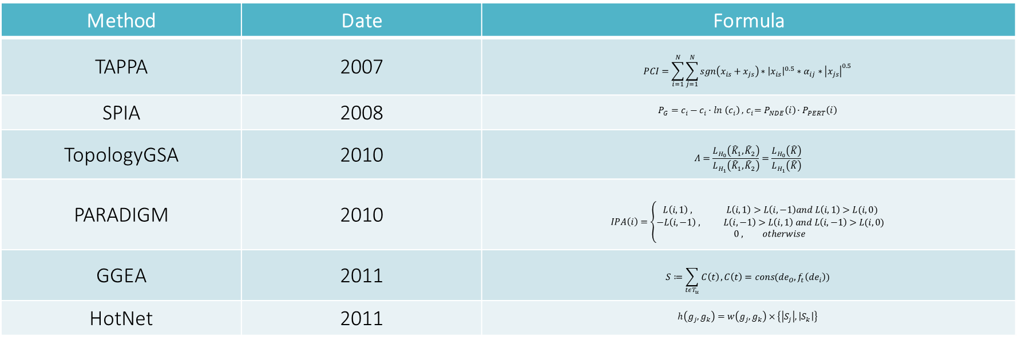
Scoring Formulas I
Method | Date | Formula
TAPPA | 2007 | $$PCI=\sum_{i=1}^{N}{\sum_{j=1}^{N}{sgn\left(x_{is}+x_{js}\right)∗{\left|x_{is}\right|}^{0.5}∗α_{ij}∗{\left|x_{js}\right|}^{0.5}}}$$
SPIA | 2008 | $$P_{G}=c_{i}−c_{i}∙ln \left(c_{i}\right) , { c}_{i}=P_{NDE}\left(i\right)∙P_{PERT}\left(i\right)$$
TopologyGSA | 2010 | $$Λ=\frac{L_{H_{0}}\left({\hat{K}}_{1},{\hat{K}}_{2}\right)}{L_{H_{1}}\left({\hat{K}}_{1},{\hat{K}}_{2}\right)}=\frac{L_{H_{0}}\left(\hat{K}\right)}{L_{H_{1}}\left(\hat{K}\right)}$$
PARADIGM | 2010 | $$IPA\left(i\right)=\left\{\begin{matrix}L\left(i,1\right) , L\left(i,1\right)>L\left(i,−1\right)and L\left(i,1\right)>L(i,0) \\ −L\left(i,−1\right) , L\left(i,−1\right)>L\left(i,1\right) and L\left(i,−1\right)>L(i,0) \\ 0 , otherwise \end{matrix}\right.$$
GGEA | 2011 | $$S≔\sum_{tεT_{u}}{C\left(t\right)}, C\left(t\right)=cons({de}_{O},f_{t}\left({de}_{i}\right))$$
HotNet | 2011 | $$h\left(g_{j},g_{k}\right)=w\left(g_{j},g_{k}\right)×\left\{\left|S_{j}\right|,\left|S_{k}\right|\right\}$$

Slide 13
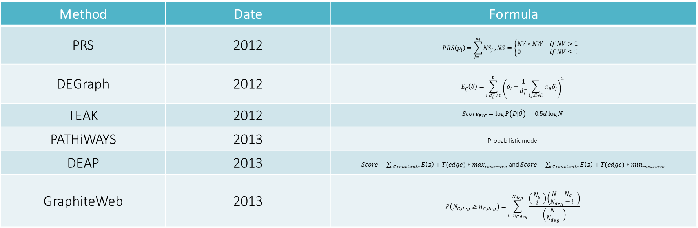
Scoring Formulas II
Method | Date | Formula
PRS | 2012 | $$PRS\left(p_{i}\right)=\sum_{j=1}^{n_{i}}{{NS}_{j}}, NS=\left\{\begin{matrix}NV∗NW if NV>1 \\ 0 if NV≤1\end{matrix}\right.\begin{matrix} \\ \end{matrix}$$
DEGraph | 2012 | $$E_{𝒢}\left(δ\right)=\sum_{i:d_{i}^{−}≠0}^{p}{{\left(δ_{i}−\frac{1}{d_{i}^{−}}\sum_{\left(j,i\right)εℰ}{a_{ji}δ_{j}}\right)}^{2}}$$
TEAK | 2012 | $${Score}_{BIC}=\log{P\left(D|\hat{θ}\right)} −0.5d\log{N}$$
PATHiWAYS | 2013 | Probabilistic model
DEAP | 2013 | $Score=\sum_{z∈reactants}{E\left(z\right)+T(edge)∗\max_{recursive}}$ and $Score=\sum_{z∈reactants}{E\left(z\right)+T(edge)∗\min_{recursive}}$
GraphiteWeb | 2013 | $$P\left(N_{G,deg}≥n_{G,deg}\right)=\sum_{i=n_{G,deg}}^{N_{deg}}{\frac{\left( \begin{matrix}N_{G} \\ i\end{matrix} \right)\left(\begin{matrix}N−N_{G} \\ N_{deg}−i\end{matrix} \right)}{\left(\begin{matrix}N \\ N_{deg}\end{matrix} \right)}}$$

Slide 14
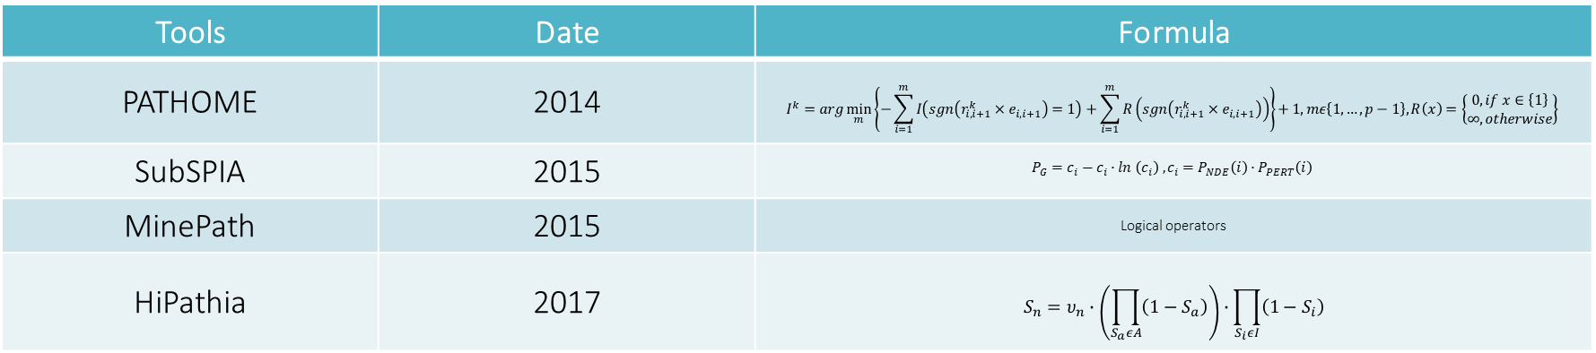
Scoring Formulas III
Tools | Date | Formula
PATHOME | 2014 | $$I^{k}=arg\min_{m}\left\{−\sum_{i=1}^{m}{I\left(sgn\left(r_{i,i+1}^{k}×e_{i,i+1}\right)=1\right)}+\sum_{i=1}^{m}{R\left(sgn\left(r_{i,i+1}^{k}×e_{i,i+1}\right)\right)}\right\}+1, mε\left\{1,…,p−1\right\}, R\left(x\right)=\left\{\begin{matrix}0, if x∈\left\{1\right\} \\ ∞, otherwise\end{matrix}\right\}$$
SubSPIA | 2015 | $$P_{G}=c_{i}−c_{i}∙ln \left(c_{i}\right) , c_{i}=P_{NDE}\left(i\right)∙P_{PERT}\left(i\right)$$
MinePath | 2015 | Logical operators
HiPathia | 2017 | $$S_{n}=υ_{n}∙\left(\prod_{S_{a}εA}{\left(1−S_{a}\right)}\right)∙\prod_{S_{i}εI}{\left(1−S_{i}\right)}$$

Slide 15
Methodology Outline
Preprocess data
Implement the scoring algorithms
Calculate the scores
Apply the Decision Tree algorithm
Validate data

Slide 16
Datasets
The GSE2034 gene expression dataset that contains 286 breast cancer samples, of which 209 are ER-positive and 77 are ER-negative (https://ncbi.nlm.nih.gov/geo/query/acc.cgi?acc=gse2034)
A collection of 47 sub-paths in total of which 15 relate to cellular activities, 24 to signal propagation and 8 to cancer in general (https://www.genome.jp/kegg-bin/show_organism?menu_type=pathway_maps&org=hsa)

Slide 17
Data Preprocessing – GSE2034
Since a gene might be mapped to multiple Entrez identifiers, each Entrez identifier is translated to the corresponding gene
Pathway genes and gene IDs that don’t match the dataset GSE2034 entries are assigned as ‘no-Probe’
The average expression value of each KEGG ID is determined by combining all of the KEGG IDs’ expression values into a single gene
Notes:
Dictionary: key – gene, value – KEGG IDs

Slide 18
Data Preprocessing - Subpathways
Each sub-path of the dataset is divided by the nodes and edges
Since each node may contain more than one genes, the average value is determined and assigned
Data from the GSE2034 dataset are combined with the sub-paths’ dataset and create new collective data structures to simplify the analysis process
Notes:
Raw data: λίστα, κάθε αντικείμενο είναι ένα μονοπάτι σε μορφή συμβολοσειράς/κειμένου

Slide 19
Score Calculation
TAPPA, PRS, TEAK, DEAP, GraphiteWeb, MinePath and HiPathia are the methods implemented in this work according to each tool’s respective papers using the Python programming language
All tools, except MinePath and GraphiteWeb, handle non-binary data
Pathway topology is taken into account by all methodologies, however there are two approaches to the problem:
TAPPA, GraphiteWeb, TEAK and PRS are based on probability theories and comprehend pathway topology as the influence of nodes upon each another
HiPathia, DEAP and MinePath rely on the interaction type among genes and how it affects the outcome
A two-dimensional matrix with rows denoting samples and columns indicating sub-paths formed for each tool after computing the score of each sample and each sub-path in accordance with the methodology of the associated tool
The source code is available at https://github.com/fotinidrouma/Pathway-Analysis.git

Slide 20
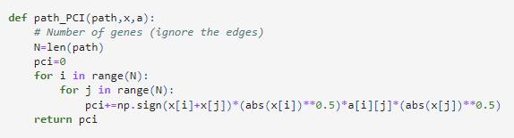
Score Calculation - TAPPA
For a given sub-path and each sample, the variable x represents the standard log expression estimate of the genes, and the respective adjacency matrices are denoted as a.

Slide 21
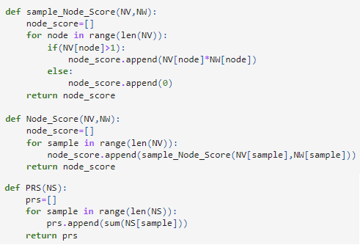
Score Calculation - PRS
Using the corresponding node values and weights, the pathway score is produced by summing the scores of each node. The non-parametric permutation method of the second normalization step of PRS was replaced with FDR correction.

Slide 22
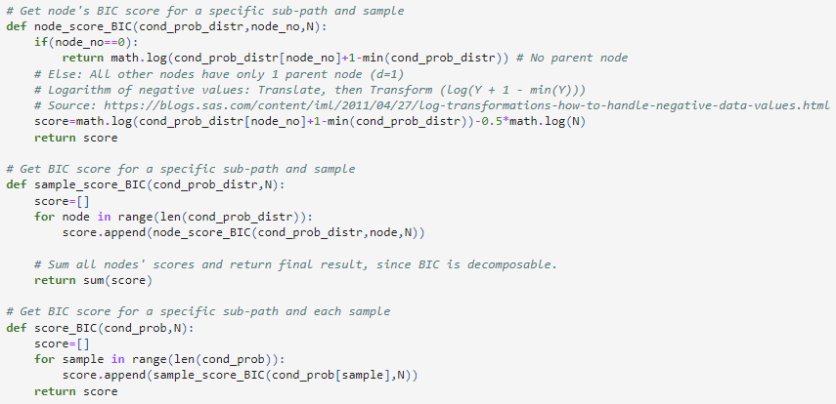
Score Calculation - TEAK
N refers to the number of samples in the expression data, while cond_prob_distr stands for Conditional Probability Distribution.

Slide 23
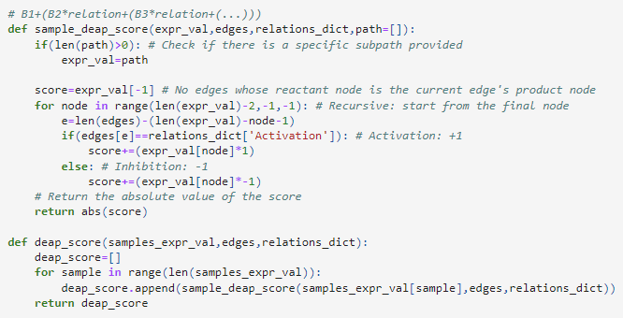
Score Calculation - DEAP
Through a recursive function, the type of gene interaction is considered. Instead of employing DEAP's random rotation method, FDR correction was employed.

Slide 24
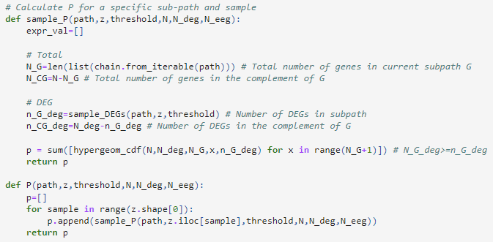
Score Calculation - GraphiteWeb
N stands for the overall number of genes screened, N_deg refers to the amount of differentially expressed genes, and N_eeg indicates the total amount of equally expressed genes.

Slide 25
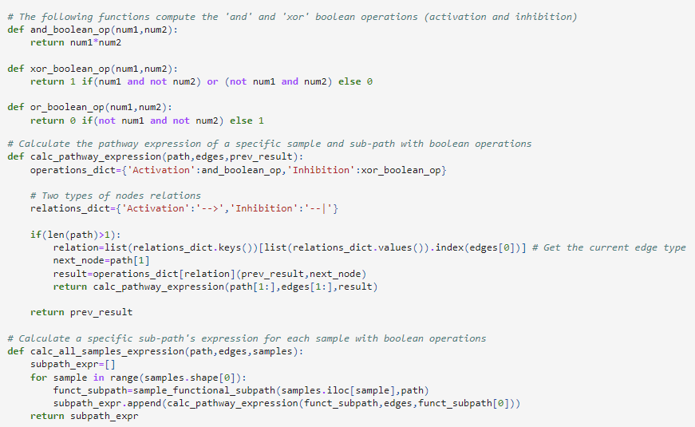
Score Calculation - MinePath
Depending on the interactions between genes, MinePath uses Boolean operators to handle binary expression values.

Slide 26
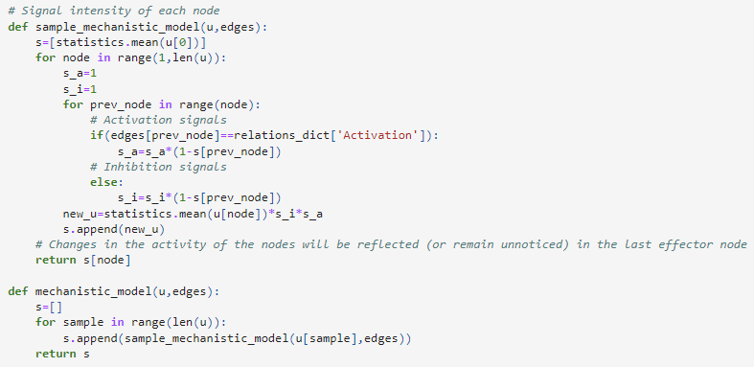
Score Calculation - HiPathia
The normalized gene expression values for a specific sub-path and sample are indicated by the variable u, which is necessary for calculating the score.

Slide 27
Decision Tree Algorithm
In order to compare the results of each methodology, the Decision Tree algorithm was utilized to train and assess each approach‘s performance and recognize the most significant sub-paths
A Decision Tree algorithm’s basis is the continuous division of the data by a specified criterion
Decision nodes and leaves illustrate the tree’s structure
Decision nodes: separate the data
Leaves: represent the options or results

Slide 28
Subpathway Ranking
Because machine learning algorithms can only handle numerical values, the categorical classes of the samples (positive or negative) of the datasets were converted into numerical variables
The updated datasets were split into training and testing sets in a proportion of 70% to 30%
Using the pre-built decision tree functions that the scikit-learn package provides for the Python programming language, the training sets that resulted from the prior stage were used to train each machine learning model, and the respective testing sets were used to evaluate each model

Slide 29
Predictive Performance I
Accuracy corresponds to the proportion of correctly predicted data points among all the data points
In the case of GraphiteWeb, the classification model’s accuracy decreased when the results were adjusted using the Benjamini and Hochberg method. Such reduction can be explained by an increase in the ability to adjust to novel, previously unseen data
In terms of the significance of each methodology's feature, no common sub-paths could be found among the tools
Tools | Accuracy
TAPPA | 54,57%
PRS | 82,09%
TEAK | 59,00%
DEAP | 77,55%
GraphiteWeb | 60,52%
MinePath | 63,05%
HiPathia | 81,49%

Slide 30
Predictive Performance II

Slide 31
Execution Time I
An algorithm’s execution time is the total time required to execute the code on the computer's central processing unit (CPU)
Tools | Execution Time (sec)
TAPPA | 3185,17
PRS | 8754,69
TEAK | 28918,27
DEAP | 24294,49
GraphiteWeb | 366047,77
MinePath | 3099,49
HiPathia | 2905,48
Notes:
GraphiteWeb: περίπου 4 μέρες
Όλα τα υπόλοιπα: λιγότερο από μία μέρα
HiPathia, MinePath, TAPPA: λιγότερο από μία ώρα

Slide 32
Execution Time II
Notes:
GraphiteWeb: παρόλο που χειρίζεται binary data, απαιτεί υπερβολικά πολύ χρόνο για την ανάλυση, οπότε λογικά το πρόβλημα βρίσκεται στην μέθοδο υπολογισμού του σκορ

Slide 33
Conclusions
HiPathia which displayed high accuracy rate and the lowest execution time, is the best option for online analysis
The findings suggest that machine learning-based techniques outperform statistical methods in terms of performance and speed, since they can handle huge amounts of data better
Most of the studied tools handle non-binary gene expression data, confirming their preference for continuous values, because they retain information that may be valuable

Slide 34
Limitations
The abundance of genomic platforms provide inconsistent results due to differences in platform design, synthesis, and probe annotation
Machine learning in healthcare presents numerous issues, like poor data quality and ethical dilemmas
The quantity and variety of tools employed in this study are insufficient to fully support the findings
Notes:
Machine Learning – απαιτεί μεγάλο όγκο δεδομένων για την εκπαίδευση των μοντέλων
Κακή ποιότητα δεδομένων: το μοντέλο είναι τόσο καλό όσο τα δεδομένα που χρησιμοποιούνται για την εκπαίδευσή του
Ηθικά διλήμματα:
Συγκατάθεση χρήσης δεδομένων (informed consent to use data)
Ασφάλεια και διαφάνεια (safety and transparency) – δεν γνωρίζουμε την λογική των αλγορίθμων
Αλγοριθμική δικαιοσύνη και προκαταλήψεις (algorithmic fairness and biases)
Εξασφάλιση ιδιωτικότητας δεδομένων (data privacy)

Slide 35
Discussion
There are numerous studies similar to ours that attempt to identify the optimal approach or develop a novel hybrid methodology
Our findings support earlier research showing that machine learning techniques and non-binary data are preferable for pathway analysis
Other relevant research also point out the issue with the plethora of platforms

Slide 36
Future Work
Conduct further research while taking into consideration proportionately additional tools from each approach
Use the scripts presented in this paper to analyze gene expression data from various genomic platforms
Focus on non-binary gene expression data and primarily employ machine learning to study gene expression and gene regulatory networks
Integrate GraphiteWeb’s methodology with HiPathia’s scoring algorithm to accelerate execution

Slide 37
Thank You! For Your Attention
Notes:
Title: Ανάλυση εκφράσεων γονιδίων και ρυθμιστικών δικτύων γονιδίων με στατιστικές μεθόδους και μεθόδους μηχανικής μάθησης

